Slide 1
GIS IN ASSESSING CLIMATIC RISKS IN SAVANNAH AGROECOLOGICAL SYSTEMS
Submitted by:
G Roopa- 103117040
L Keerthi- 103117086
Sarishma Bhandari- 103117086

Slide 2
INTRODUCTION
Globally 80% of the agricultural land depends on Natural Precipitation.
Drought, one of the climatic extremes is mostly related to reduction in the amount of precipitation received and increased evapotranspiration over an extended period, is highly unpredictable, variable and virtually occurs in almost all climatic zones.
It is estimated that unlike other extremes (floods or storms) drought affect 10% of the country’s population, 13% in developing countries.
Climate variability and change are increasingly becoming significant challenges in agro ecological system and constitute some one of the most persistent risks to agriculture in particular.
Ghana, one of the Sub-Sahara African (SSA) Countries faces numerous risks due to severe variability in climate and extremes like drought because most people’s livelihood activities rely on climatic phenomenon like precipitation.
This is particularly true for the northern Sudan Savannah Zone (SSZ) of Ghana, where rain-fed agriculture is predominant source of livelihood for small holding farmers.

Slide 3
According to FAO, between 1980-2014, 363 million people were affected in SSA countries by the drought episodes, 74 million alone in west SSA. The most affected people being small holding farmers who inhibited the most vulnerable and marginal lands.
Therefore in recent times there has been increasing concerns about the variability in drought frequency and severity and how it impacts agriculture. However, in developing countries drought management is untimely and poorly coordinated.
The Climate Risk Assessment (CRA) is a key element for Climate Risk Management (CRM).
CRA is calculated as the probability of negative impact caused by interactions between hazard, exposure, vulnerability.
CRM in the context of agro ecological system is the distribution of appropriate climate information through an effective delivery system which can alert relevant stakeholders (farmers, policy makers etc) of imminent climate hazards to assure food and water security.
According to Africa Development Forum (ADF) integration of CRA and CRM will present a real opportunity to decision makers who seek to understand the dynamics of climate change adaptation and prioritize for sustainable agriculture.

Slide 4
The upper east SSZ part of Ghana (the study area) has experienced frequent drought episodes in past decade (2008, 2013, 2015 farming seasons), receives the lowest amount of rainfall and has the highest number of poor people depending upon climate sensitive farming and animal husbandry. All these factors suggesting the vulnerability of area.
Furthermore the cumulative nature of drought episodes and relatively high aridity engender bushfire, escalating the already precarious situation.
Though Ghana is expected to have increase variability of extreme events in next two decades, spatial distribution of associated risks remain sparsely studied.
Using the relevant tools for spatial mapping of drought risk in SSZ of Ghana, the study is implemented so that there is a paradigm shift from emergency response to risk management.

Slide 5
OBJECTIVE
The objective of the study is to form a spatial mapping of drought risk in the SSZ region of upper east Ghana by using Geospatial Techniques.

Slide 6
METHODOLOGY
Drought risk in Sudan Savannah Zone was used as a proxy and the study employed geospatial techniques to assess the spatial distribution of climate risks in semi-arid Ghana.
In this paper Drought Risk was conceptualized as a product of zone’s exposure and vulnerability to a drought hazard.
The drought risk assessment model by Ghana Environmental Protection Agency (GEPA) which was tested and validated within the local context was used.
Probability maps were generated using ArcGIS 10.3 from the biophysical indicators such as climate, soil, land use etc to develop drought hazard and drought vulnerability map.
The drought hazard and drought vulnerability map was reclassified and weighted overlay to produce drought risk map.

Slide 7
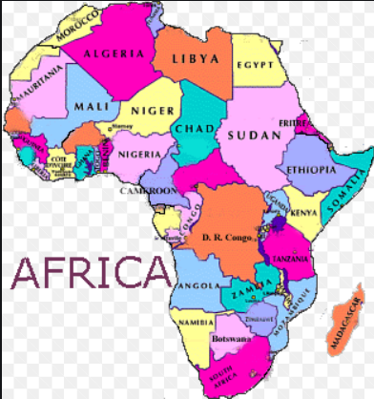
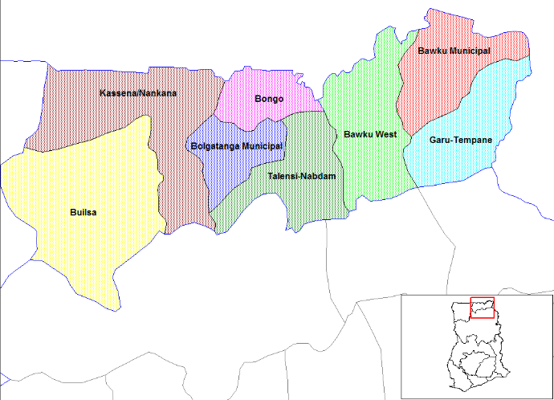
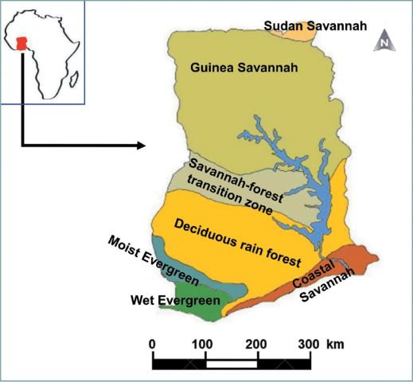
EXPLANATION OF THE WORK
The upper east region of Ghana with Sudan Savannah Zone(SSZ) which lies in Africa Continent was used as the study area because of the variability in climate the zone has experienced in the past decade also its vulnerability.
It covers an estimated area of 1900 square kilometres. It includes Bawku Municipality, Northern Region of Garu Tempane, Bawku west and Bongo.
Fig: Districts in upper region of Ghana
Fig: African Continent
REFERENCE IMAGE FROM GOOGLE
Fig: Sudan Savannah Zone in upper east region of Ghana

Slide 8
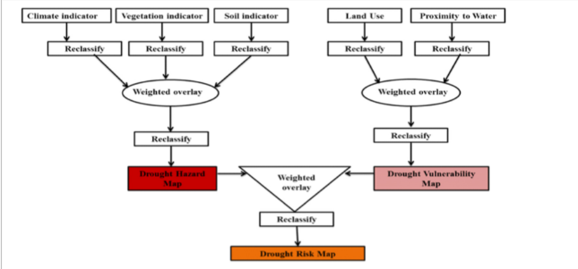
Fig: Drought Risk Model Adapted from GEPA (2012)

Slide 9
The process of mapping the distribution of drought risk was done through the drought risk assessment model adapted from GEPA.
The model was built on four main procedures. They are deﬁnition of goal or theme of investigation, identifying criteria, standardization and weighting, which were all undertaken spatially within a geographic information systems (GIS) platform.
For the mapping of drought hazard map three indicators were taken namely climate, vegetation and soil indicators.
Climatic Indicator: The climate indicator was derived from the combined computation of spatial data on annual average precipitation and temperature. The De Martonne Aridity Index (IDM), which provides a measure of the degree of dryness in an area, was used to derive the climate indicator layer as an input in the risk model.
The IDM was derived using the following equation : IDM = P/(T+10)
P is annual precipitation (mm) and T is the annual mean temperature (°C). The De Martonne climatic classiﬁcation table is shown in Table 1.

Slide 10
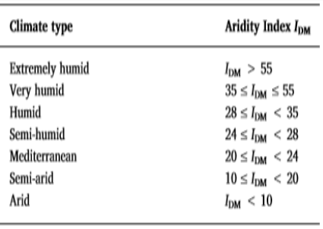
Vegetation Indicator: The basic data for the estimation of the vegetation indicator was the average Normalized Diﬀerence Vegetation Index (NDVI) of the area. The NDVI was generated from Landsat 8 satellite image of the study area.
Soil Indicator: The categorization of soil in the SSZ was based on the Food and Agriculture Organization (FAO) soil classiﬁcation scheme. Five main soil types were identiﬁed in the study area namely lixisols, leptosols, ﬂuvisols, luvisols and greysols. These were then overlaid to get a composite soil indicator map.
Each of the three composite maps (climatic indicator, vegetation indicator, and soil indicator) were reclassiﬁed and weighted overlay operation carried out using the weighted overlay tool in ArcGIS 10.3. After the overlay, the output was reclassiﬁed to produce drought hazard map.
Fig: TABLE 1

Slide 11
To map ecological drought vulnerability, proximity to water and land use/cover indicators were used.
The land use/cover (LULC) input was derived from processing the Landsat 8 satellite image of the Sudan Savannah Zone of Ghana.
The distance to water was derived from the drainage map with distance calculations undertaken in ArcGIS 10.3.
Both land use and distance to water indicators were reclassiﬁed and then a weighted overlay performed.
After the overlay, the results were reclassiﬁed to produce the drought vulnerability map as an input for producing the drought risk map. The drought hazard map and vulnerability map were also weighted, overlaid, and reclassiﬁed to produce the output drought risk map.

Slide 12
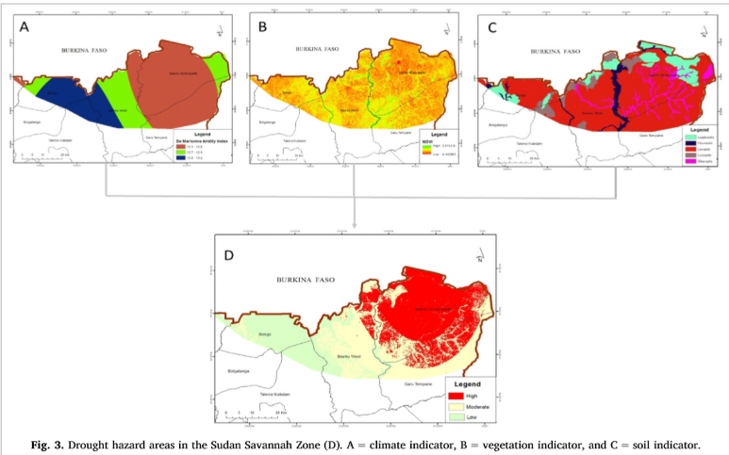
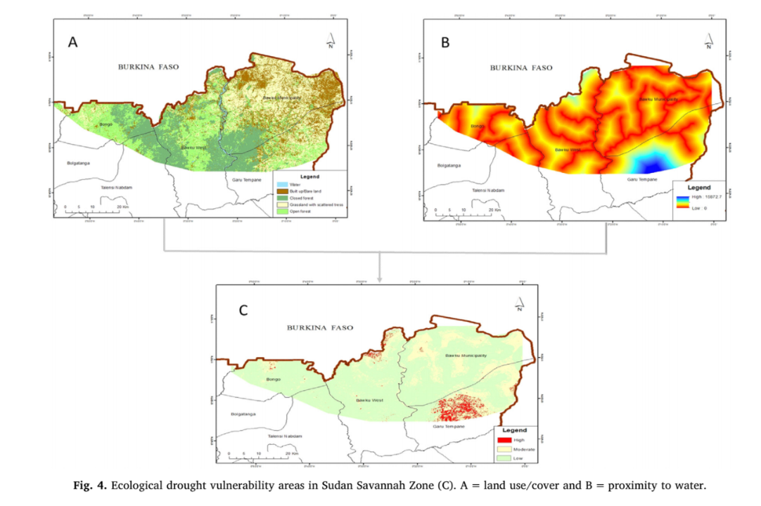
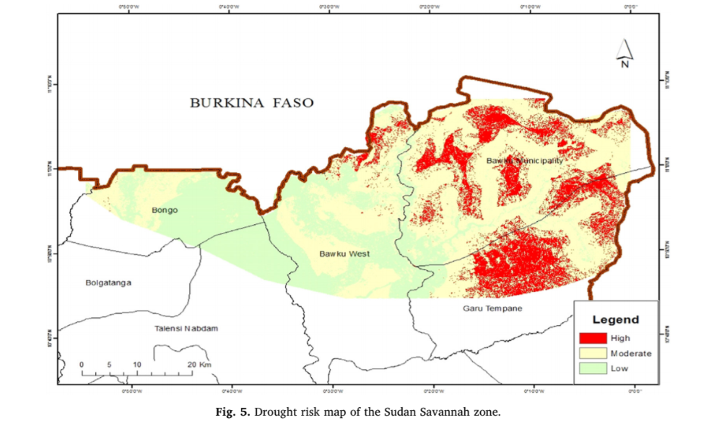

Slide 13
SUMMARY
Globally agricultural sector is the most exposed sectors to climate related hazards.
Therefore climate risk mapping within the context of agro ecological systems is an essential ingredient that could facilitate effective and proactive management of losses and damages from climate variability and extreme events.
According to the drought risk map of SSZ in upper east region of Ghana we can conclude that 69% of the zone fall under moderate – high drought risk. The areas under this influence mainly include the Bawku Municipality, Northern Region of Garu Tempane.
The remaining 31% of the zone fall under low drought risk which includes area through Bawku west and Bongo. The small holder farmers in these two districts could thus experience high losses in crop failure, increased food insecurity and general loss of livelihood during the major drought episodes.

Slide 14
RECOMMENDATION
Since we are no strangers to the dire consequences we are facing due to climatic variation in today’s world, along with research in the agro ecological fields, declination in water resources, increase in earth’s temperature should also be encouraged by the government. The research done in the vulnerable communities all over the world will thus help in a paradigm shift from emergency response to risk management.
In the study an additional map classifying the intensity of drought in the area should be mapped.

Slide 15
REFERENCES
African Development Forum(ADF), 2010.
Food and Agricultural Organization(FAO), 2010 and 2017
International Fund for Agricultural Development( IFAD)
Ministry of Environment, Science, Technology and Innovation(MESTI), 2012, 2013,2015
Climate Change Adaptation in Africa Programme(CCAA)
Ministry of Food and Agriculture (MoFA)

Slide 16
THE END

